Slide 1
Ethics in the CSE Capstone
Matthew Hertz
mhertz@buffalo.edu
https://cse.buffalo.edu/~mhertz/

Slide 2
CSE442 – Software Engineering
Course serves as capstone for computer science majors
  Include heavy assessment responsibilities for ABET
Offered every term & typically taken by students in the last year
Recent enrollment averages 150 students/term
  Enrollment not homogenous, but diversity still limited
Course organized around group projects completed over term
  Projects & teams selected by students (with guidelines)
  Team have 3 – 5 students; lectures include team activity
Notes:
Diversity:
18% of the students are international
14% of students are underrepresented minorities
14% of students are female (1 student is an URM female)

Slide 3
"Ethics Week"
Week of lectures, activities, & discussions about ethical issues
  Reinforces ethical lessons from other classes; UB capstone
  Needs ability to assess individual students for accreditation
Students very excited by chance to discuss topics

Slide 4

"Ethics Week"
Week of lectures, activities, & discussions about ethical issues
  Reinforces ethical lessons from other classes; UB capstone
  Needs ability to assess individual students for accreditation
Students very excited by chance to discuss topics
Notes:
Image used under Pixabay License which allows use for non-commercial purposes. Original available at: https://pixabay.com/photos/bored-female-girl-people-school-16811/

Slide 5
"Ethics Week"
Week of lectures, activities, & discussions about ethical issues
  Reinforces ethical lessons from other classes; UB capstone
  Needs ability to assess individual students for accreditation
Students very excited by chance to discuss topics
actively applying for jobs
reached part of term where end is visible
want to be anywhere BUT classroom
know everything they need about ethics & real-life

Slide 6
Our Ethics Rubric
Developed as part of our grant from Mozilla foundation (thanks!)
  Included input from faculty across departments and schools
Goal was to highlight issues while still being broadly applicable
  Broad language valuable for faculty
  Blasé students ready to dismiss anything academic
Outlines ethical dimensions for students to evaluate problem
  Stole ideas from many existing rubrics
  Added focus on types of problems CS student likely to face

Slide 7
Our Ethics Rubric
Developed as part of our grant from Mozilla foundation (thanks!)
  Included input from faculty across departments and schools
Goal was to highlight issues while still being broadly applicable
  Broad language valuable for faculty
  Blasé students ready to dismiss anything academic
Outlines ethical dimensions for students to evaluate problem
  Stole ideas Drew inspiration from many existing rubrics
  Added focus on types of problems CS student likely to face

Slide 8
Rubric Criteria
Wanted assignment which exposed students to as many criteria as possible
"Main" assignment at week's end, but too late by then
  Wanted activity to start week and get students' attention
Students identify the ethical problem(s) presented in the scenario
Students identify the stakeholder(s) in the scenario
Students explain the potential biases in the data or algorithms used in the scenario
Students anticipates ethical or fairness problems that may arise when the algorithm is deployed
Students describe the impact(s) of their proposed solution
Students describe and compare other possible solutions with their proposed solution

Slide 9
Activity Start
Have each student pick up copy of activity & get in project teams
Ask students to review dossier created for activity
  Explain that all data on dossier could be real
Basis of "facts" are very real, but chosen to avoid any offense
  Student body diverse and includes many experiences
  Not all students as tactful as I would like & avoid situation
  Names and data generic; terrorist organization out of date
Students initially wary; assume heavy-handed ethics lesson
  (They are correct, but not how they expect)

Slide 10
Activity Work
Students given 35ish minutes to answer all questions
  Reiterate that entire team must agree on all answers
First few minutes easy for student, but assume they being set up
  (Again, they are not wrong)
  Questions 1 & 2 worded to reinforce their belief and set trap
Once question 3 reached, I start probing team's reasoning
  Students rarely comfortable with answer
  Debates begin as I demand unanimity within each team

Slide 11
Last Three Questions
Social media question seems easy & most answer comfortably…

Slide 12
Last Three Questions
Social media question seems easy & most answer comfortably…
… until I get involved
  Highlight NFL player DeSean Jackson's "gang connections"
Ask about fairness and what connections really mean
  Can usually drive conversation to agree on potential bias
  If consensus reached, ask if students comfortable losing data
  Point out algorithms not biased; just following data patterns
Point out choices require that they identify unbiased data sources

Slide 13
What Will They Do Next Year?
Point to real examples where people tasked to build systems
  Most students uncomfortable with staying at job
  Losing income (& possible visa) also difficult for students
Good time to ask about their interviews and what companies do
Much less work to do now, team's drive their internal debates

Slide 14
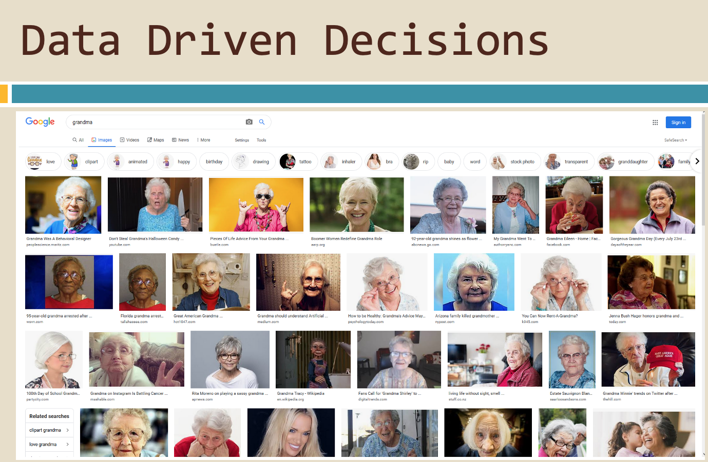
Follow Ups
Start by showing examples of "just following data"

Slide 15
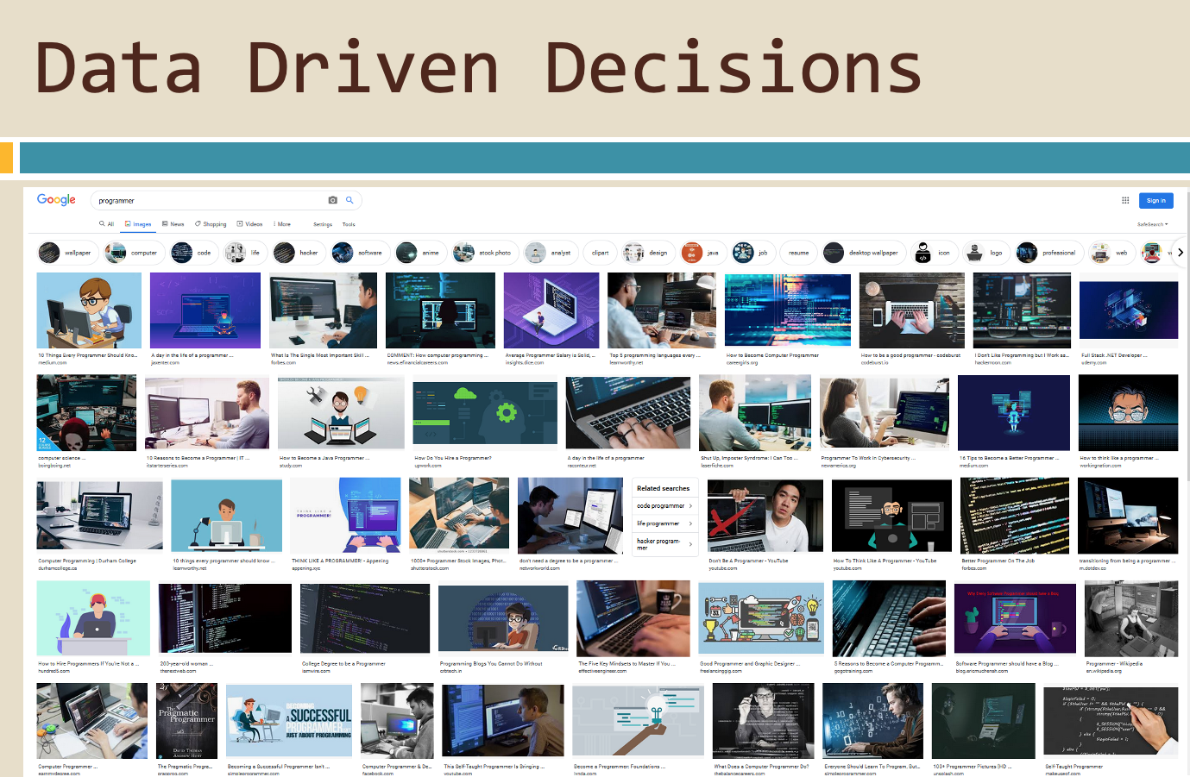
Follow Ups
Start by showing examples of "just following data"

Slide 16
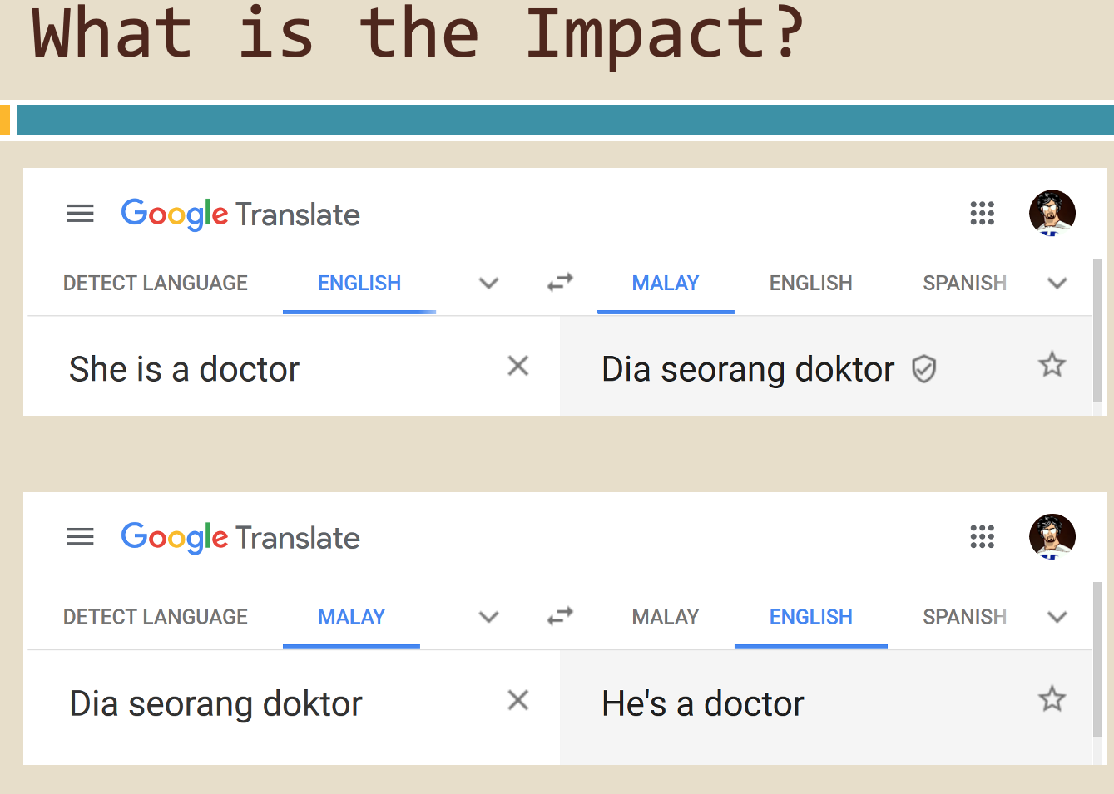
Follow Ups
Start by showing examples of "just following data"

Slide 17
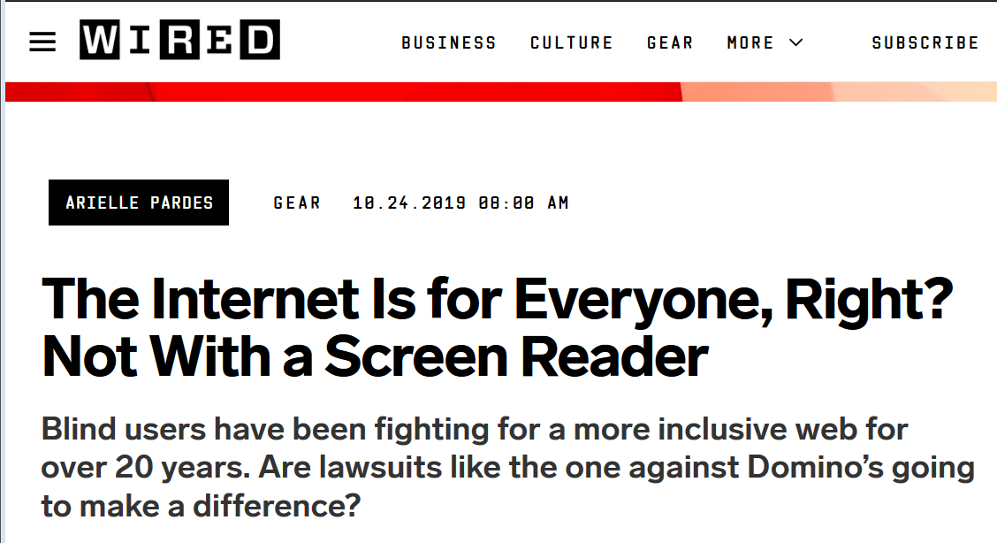
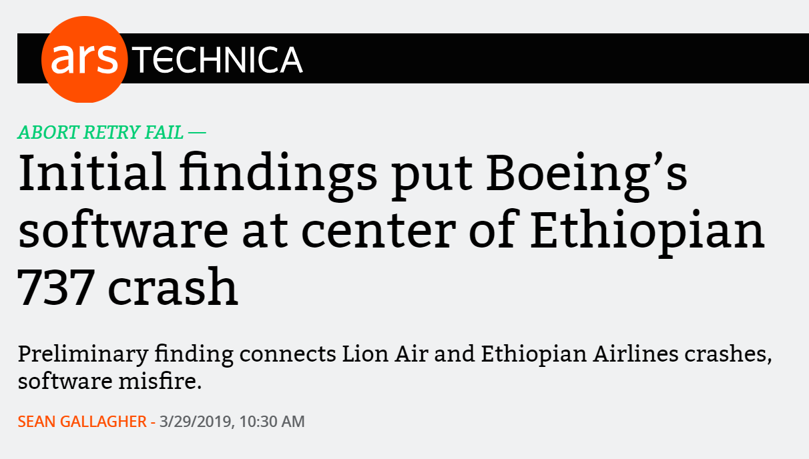
Expand Ethical Issues To Consider

Slide 18
End Result
Build upon activity by ending week ends asking student to write 1 page on ethics and their team's project
  Most common answer:
  "There are no ethical implications of our project"

Slide 19
End Result
Build upon activity by ending week ends asking student to write 1 page on ethics and their team's project
  Most common answer:
  "There are no ethical implications of our project"
  😭
More work remains; any suggestions welcomed

